Slide 1

Chandigarh Group of Colleges Jhanjeri, Mohali – 140307 Department of Computer Science and Engineering
Live Logging Attendance System
Project II
Project Member : Project Mentor :
Prerna Sharma 1816589 Ms. Sakshi Sharma
Abhinandan Kumar 1816823 Prof. Software Engineering
Prince Kumar 1816590

Slide 2
Outline
Introduction
Objective
Significance
Work Flow
Methodology
Libraries
Conclusion

Slide 3
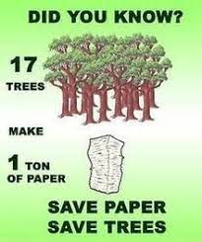
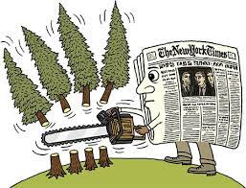
Introduction
According to the survey a single tree produces 10,000 to 20,000 papers.
Papermaking has an impact on environment because it destroys trees continuously in every single day. According to the data from the Global Forest Resource Assessment roughly 80,000 to 160,000 trees are cut down each day around the world for papermaking by the paper industry.

Slide 4

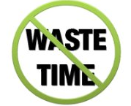
Traditionally attendance is marked manually and they must make sure correct attendance is marked for respective student.
This whole process correct information is missed due to fraudulent and proxy cases.

Slide 5
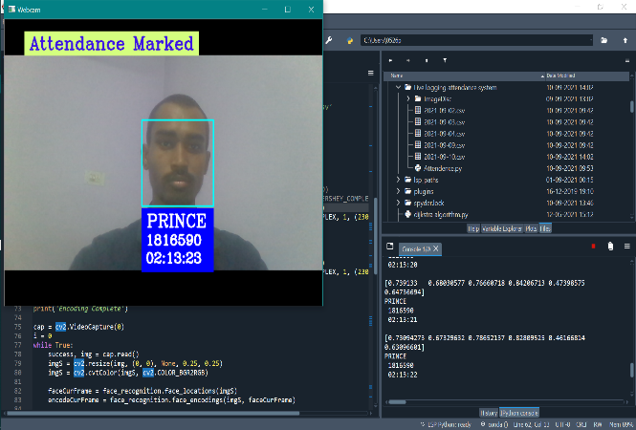
Objectives
This project is based on the technology of Machine Learning and AI, it marking attendance from detecting faces of persons. It detects the face of person in real time using webcam. The Machine Learning techniques we use in this project is image analysis, face detection, face recognition and computer vision. To develop a portable Smart Attendance System which is handy and self-powered.
Logging Attendance

Slide 6


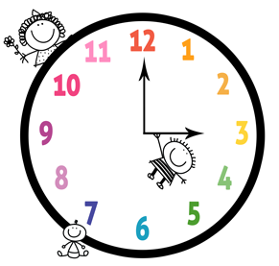

Significance
1-Automated
3-Effective
2- Economically
4- Keep extra time

Slide 7
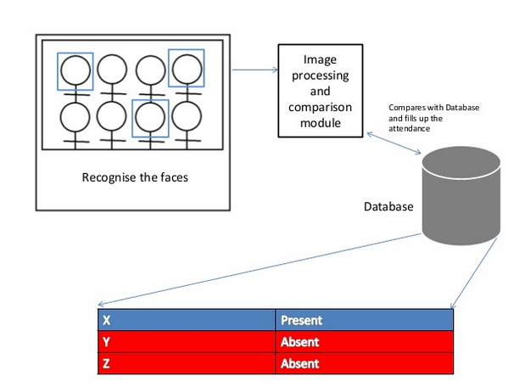
Work Flow

Slide 8

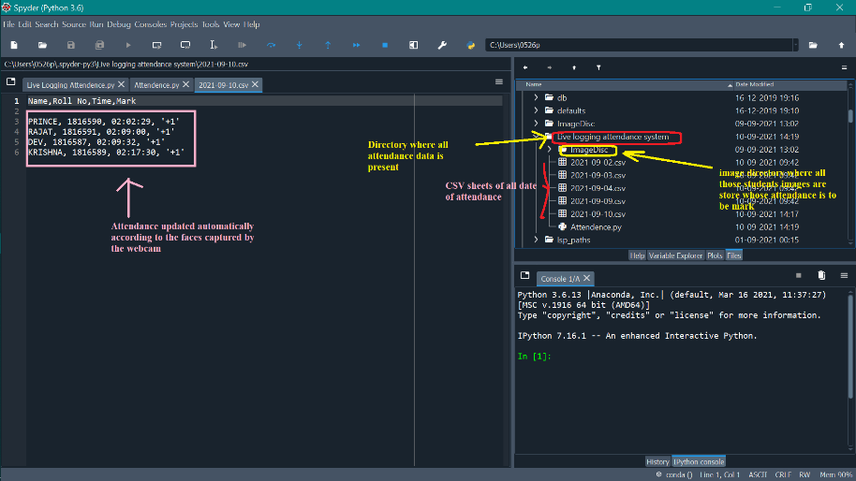
Methodology
Loading Image Data
Method to read image
Method to display image
Resizing image
Video frames
Encoding of Load Image
Encode all the imges present in the directory
Store all the encode list inside the list
While use thses encode at the time of compare faces

Slide 9

Video Streaming & Real Times 1. Method to capture video 2. Video Streaming 3. Encode the faces in the current frame 4. Compare the captured face in real time

Slide 10
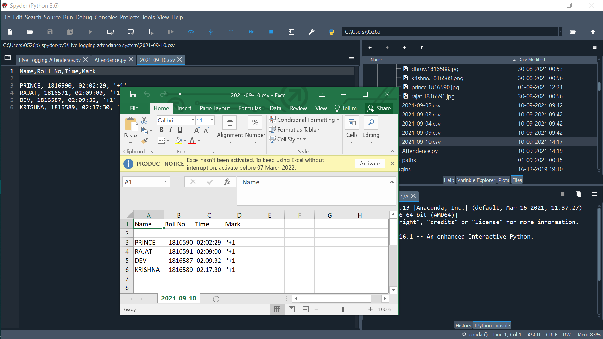
Create and Update CSV sheet 1. Create csv sheet of particular date 2. Update name, roll, time of matched persons 3. Check data sheet if name is already present then it is not overwrite or update again Time and Date 1. We uses datetime library for capture the actual time 2. We grab the actual date and time using datetime function with the help of “.now()” 3. With the help of date we predict, that particular date attendance is marked or not 4. With the help of time we record it which time he enter in the class

Slide 11
pytz
We uses pytz library with datetime because there is problem in datetime library it is depend on the source of any device which display time
Like if we not use pytz library then it grab the time which is shown in by the cpu or such type of devices
Using that library we can grab the locality time such as our locality time is Asia/Kolkata
We need to pass the locality which locality time you want to grab
Compare Faces
Compare faces is a inbuilt function of face recognition which helps to compare the two or more faces
We can compare these encoding of faces to all the encoding of images present in the directory
Select the best matches of images

Slide 12
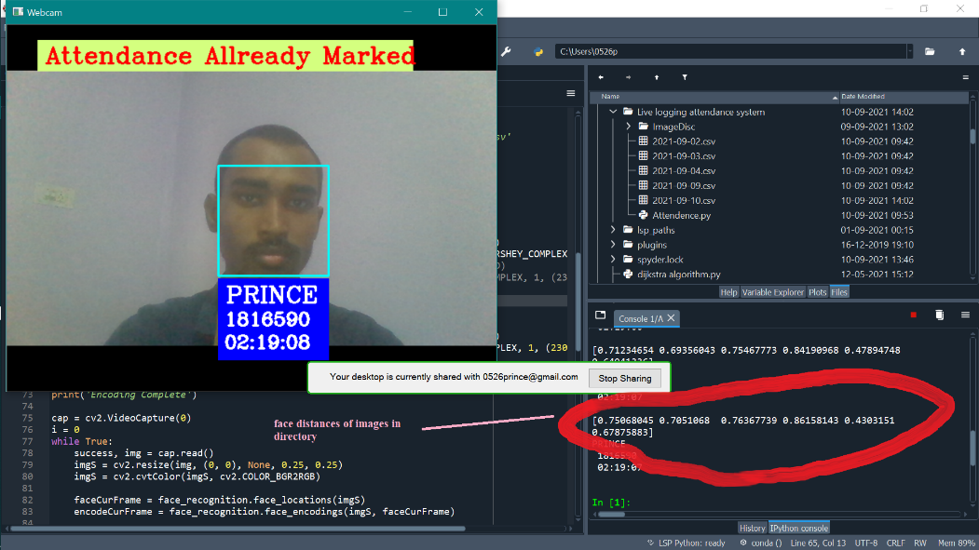
Face Distances
Face recognition also provides the function which helps to find the face distances of faces
According to the compare of faces the best matches faces has min face distances
And if the faces is not matched then the face distance is maximum as comparative to the best matches,

Slide 13
Library
Numpy: It requires for the mathematical calculation which we are not able to do manually.
Open CV2: For image and video processing we use the cv2 library for read the file directory.
Face Recognition: Face recognition is use for detecting faces in in the images or in video frames. It contains lots of function such as “encoding” we use it for encode faces from imge or video frames. “face distance” calculate face distance to check the best match.
Time and Date: It uses to grab the actual date or time. We are using the library for that purpose for is datetime.
Pytz: It is uses for grab the Indian standard time Asia/ Kolkata. Without depends on cpu or any other divices time source. It grabs automatically when it will be execute
CSV Files: It uses to create csv data sheet for mark attendane or update the attendance. We can check it on externally. Or we can also convert into excel files according to their needs and desire.

